Slide 1
IBK KW Filterability Analysis and Prediction

Slide 2
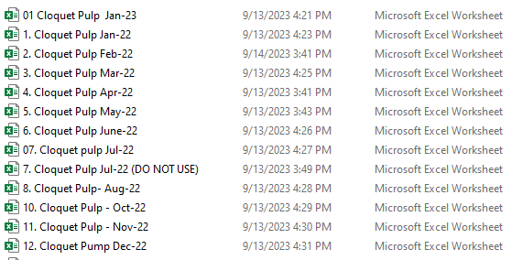
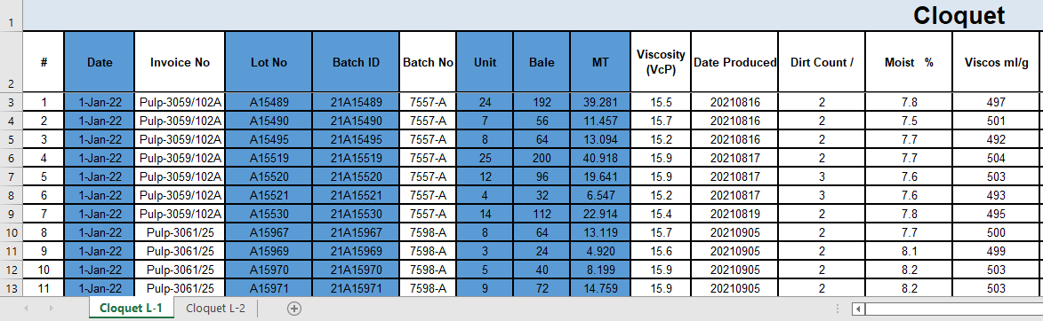
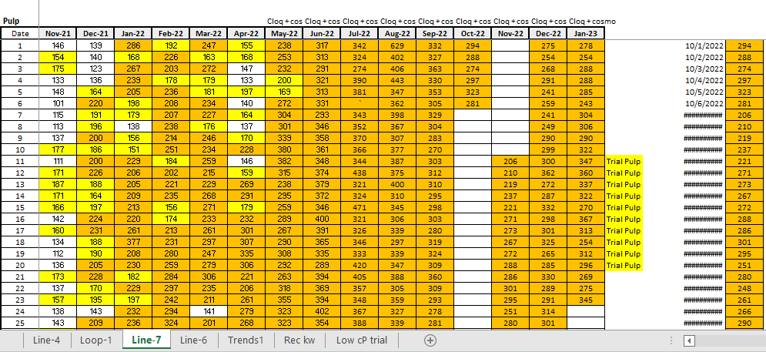
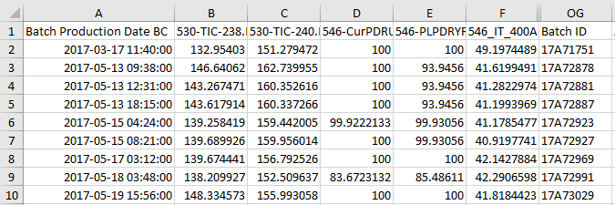
… selected six (6) highlighted variables
1. join by Batch ID
… KW, Loop 1_2
… Batch Prod Date BC, BC variables, Batch ID
2. join by LOOP

Slide 3


… selected six (6) highlighted variables
1. join by Date & LOOP
2. join by Batch ID
… Date, Loop 1_2
… Batch Prod Date BC, BC variables, Batch ID

Slide 4
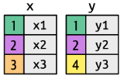
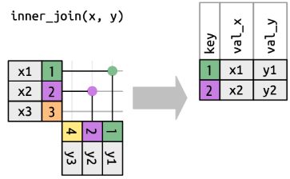
Merging data {Joins}

Slide 5

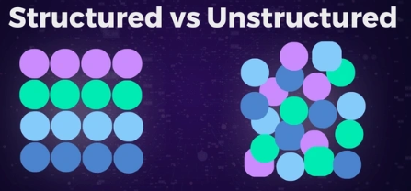
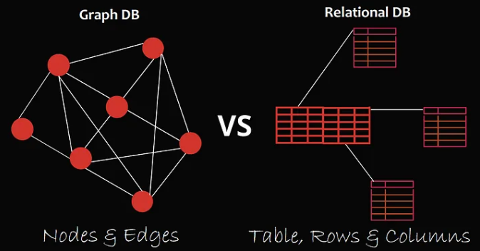
Structured vs Unstructured data
The only worse thing than no data is bad data,
but please don’t throw the baby out with the bathwater.
Unstructured
Structured
For machine learning analysis, all rows must be filled with data, else it would result in dropping multiple rows (weeks/months of data), or an entire column (variable).
Quite peculiarly, it turns out that some aspects of pH are important in the IBR KW Filterability analysis. Less than 10% of the variable had questionable data and does not meet the threshold to drop the entire column and lose 90% of good data, which could be important to the analysis; throwing away a year’s worth of data because of 2 – 3 weeks of inaccurate readings. One does not know important variables from the outset.
possible to pick specific data to eliminate, without much additional effects
Trade off between dropping entire columns (missing out on potentially useful variables) or entire rows (losing information on several weeks of observations from hundreds of sensors).

Slide 6

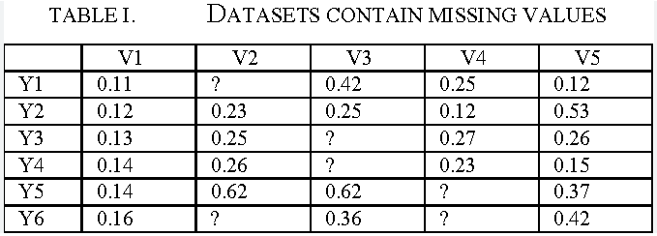

Sparse data
400 columns
43000 rows
24% of missing data.
75% of incomplete rows. Cannot do machine learning analysis with incomplete rows.
Techniques exist for handling missing data, but most are not applicable to our case.
Simply dropping all rows with missing data only left us with June 2022 data.
Had to selectively drop certain columns that had the most recent missing data.

Slide 7
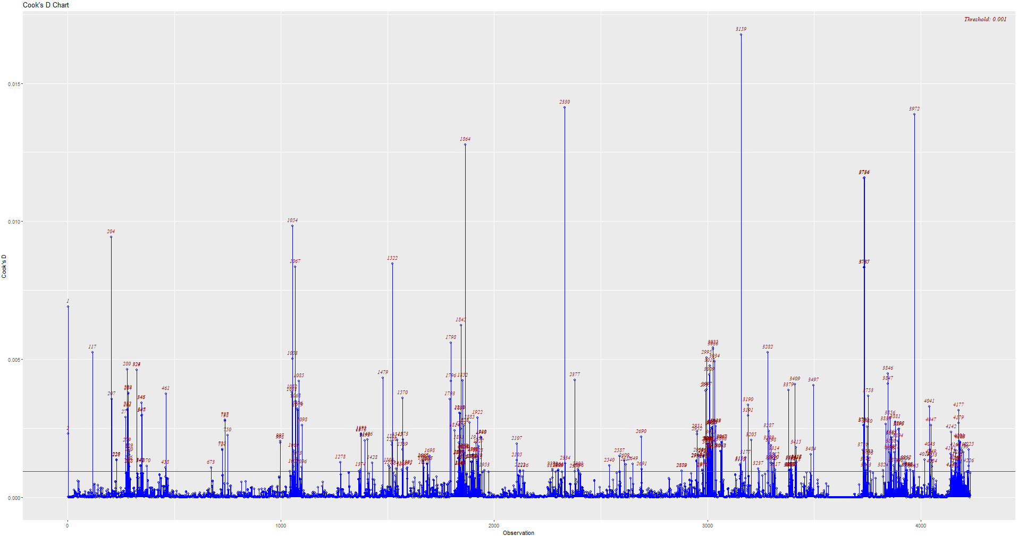
Cook’s distance
Filtered out Maple % < 24
Filtered out Aspen % > 76

Slide 8
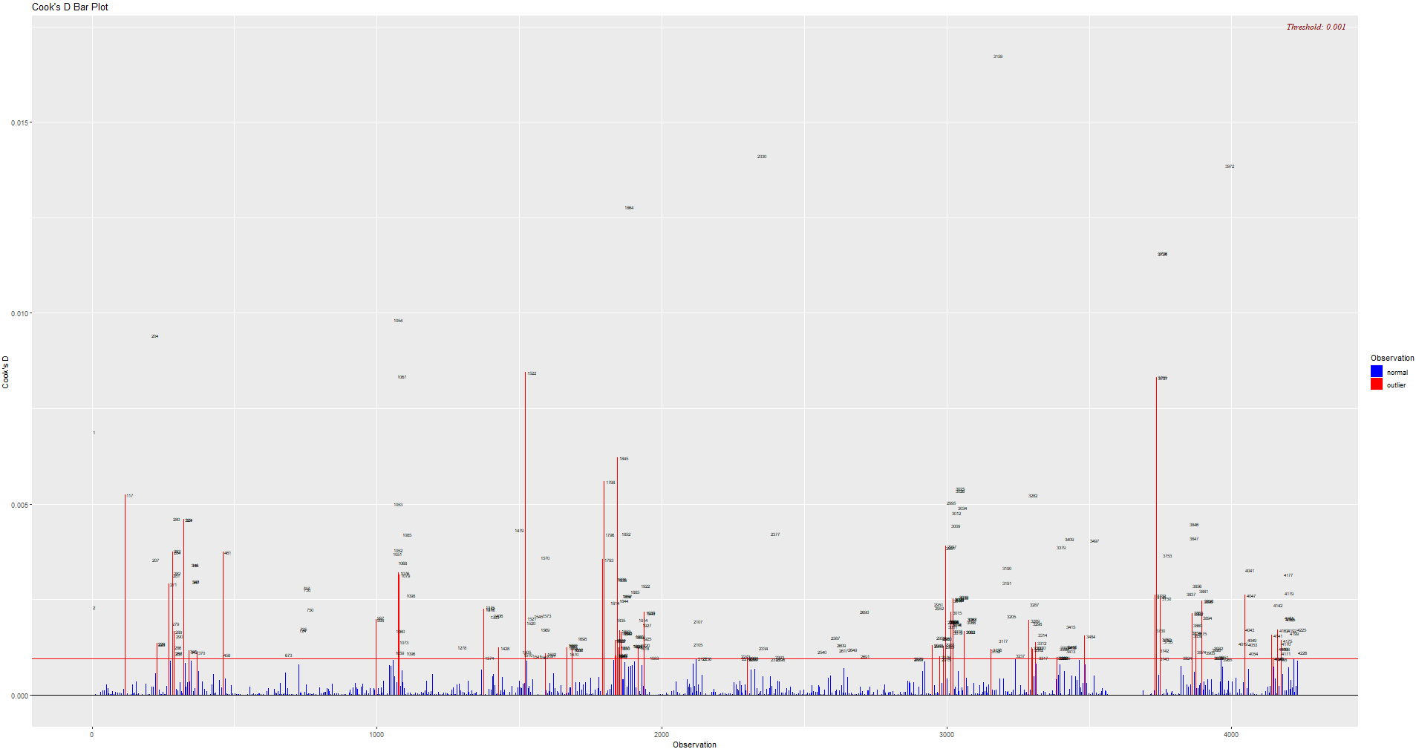
Cook’s distance
~360 variables
Filtered out Maple % < 24
Filtered out Aspen % > 76
~4250 observations

Slide 9
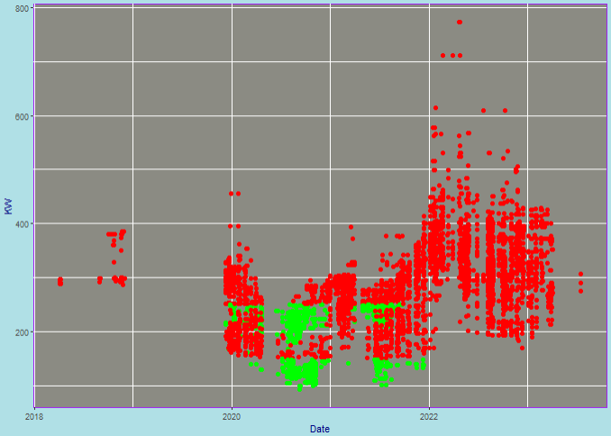
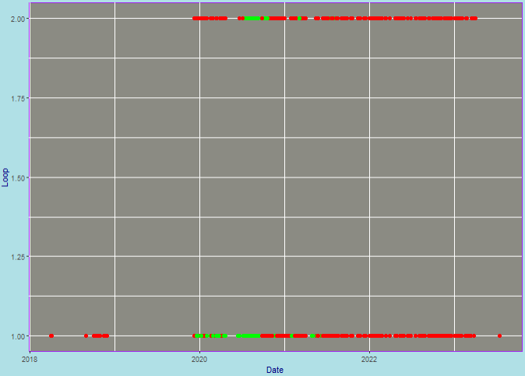
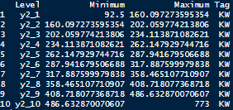
Data for modelling (April 2018 – July 2023)
Target variables:
Loop and Daily IBR KW Filterability
< 262.2 KW = “GOOD”
< 160.1 KW = “GOOD”
Loop 1:
Loop 2:

Slide 10
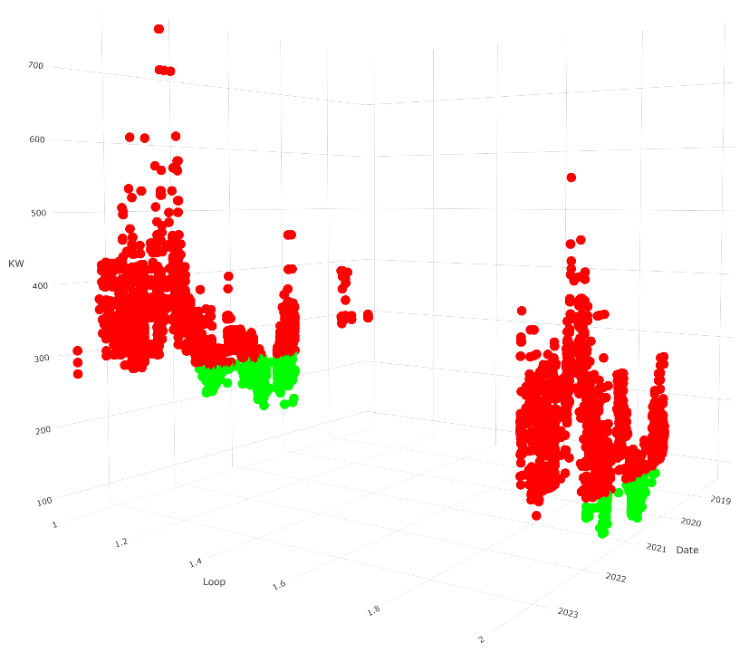
Data for modelling (April 2018 – July 2023)
Target variables:
Loop and Daily IBR KW Filterability
< 262.2 KW = “GOOD”
< 160.1 KW = “GOOD”
Loop 1:
Loop 2:

Slide 11
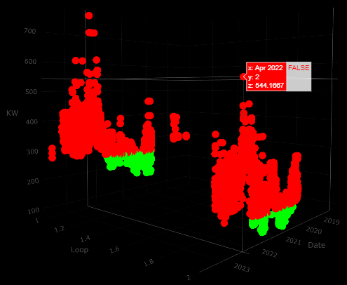
Data for modelling (April 2018 – July 2023)
Target variables:
Loop and Daily IBR KW Filterability
< 262.2 KW = “GOOD”
< 160.1 KW = “GOOD”
Loop 1:
Loop 2:
Total observations: 12093
Total Good = 21% (Loop 1: 15.4% | Loop 2: 5.7%)
Total Bad = 79% (Loop 1: 47.6% | Loop 2: 31.3%)
Loop 1 Loop 2
Good: 1858 Good: 691
Bad: 5762 Bad: 3782
Total: 7620 Total: 4473
Good: 24.4% Good: 15.4%
Bad: 75.6% Bad: 84.6%

Slide 12
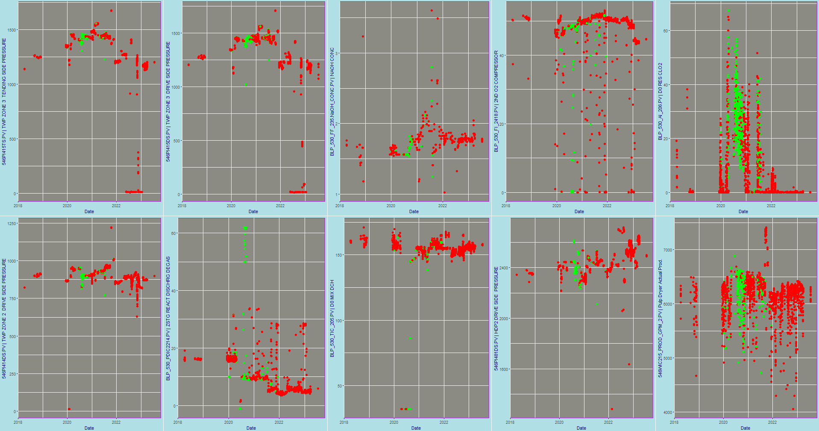
Time Plots (Top 10)

Slide 13
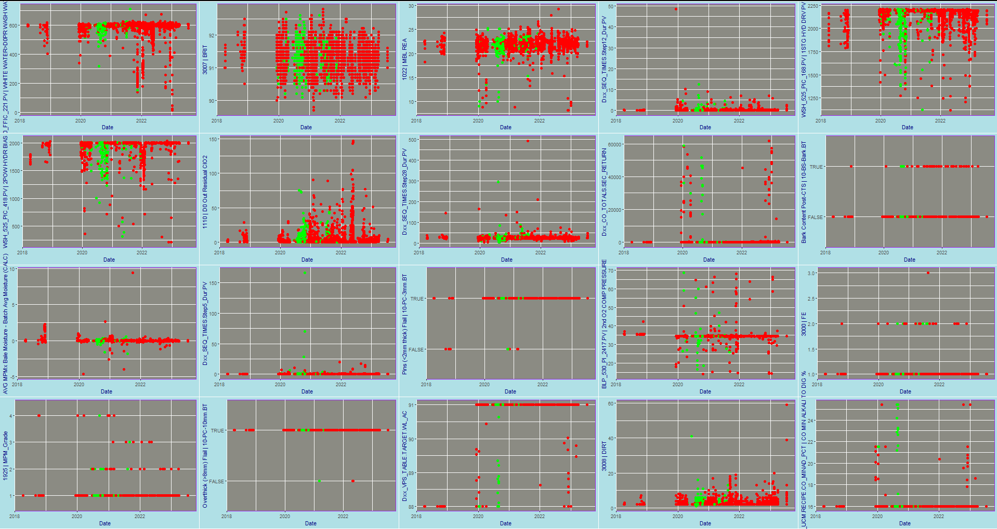
Time Plots (Bottom 20)

Slide 14
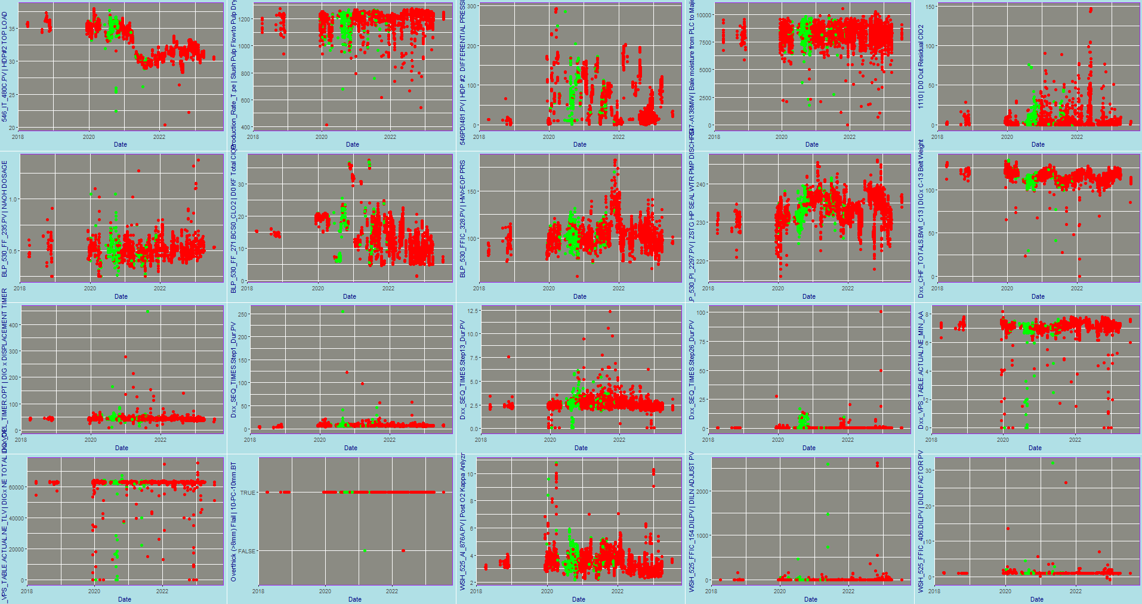
Time Plots (Some 20)

Slide 15

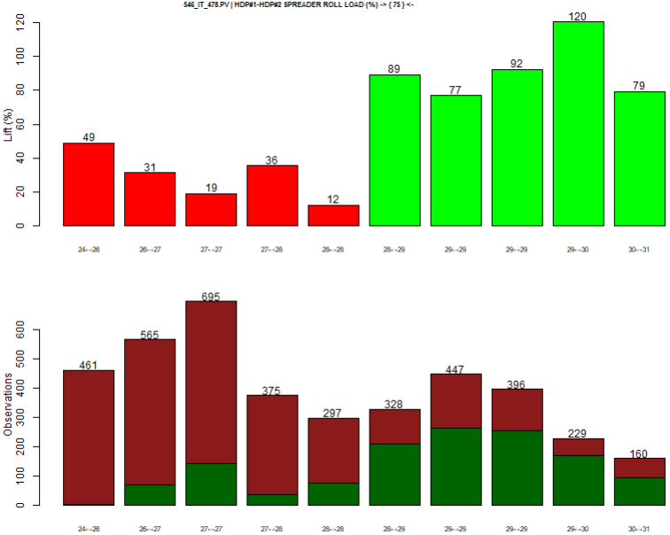
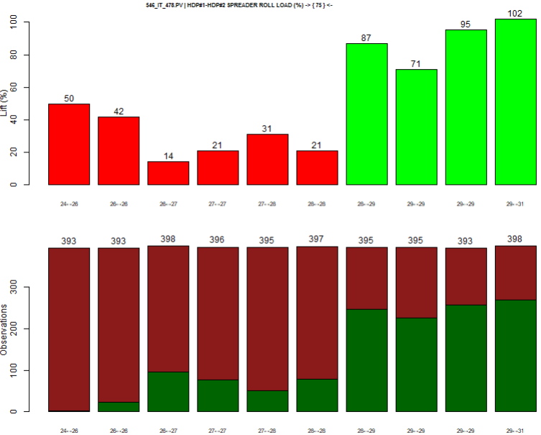
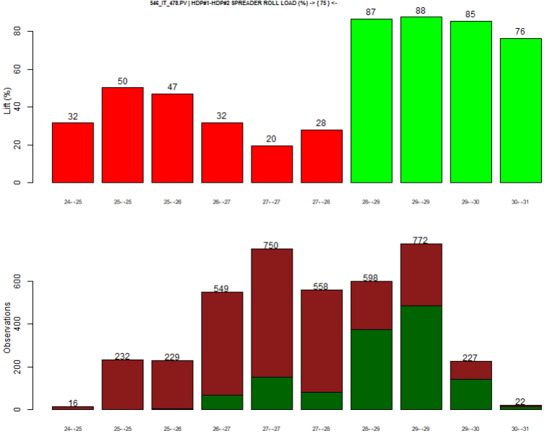
Discretization
Cluster
Frequency
Interval
Fixed
For categorical data

Slide 16
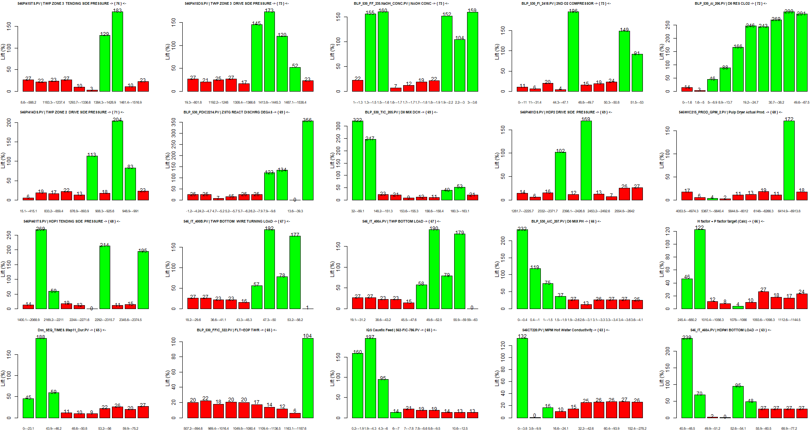
Lifts (TOP 20)

Slide 17
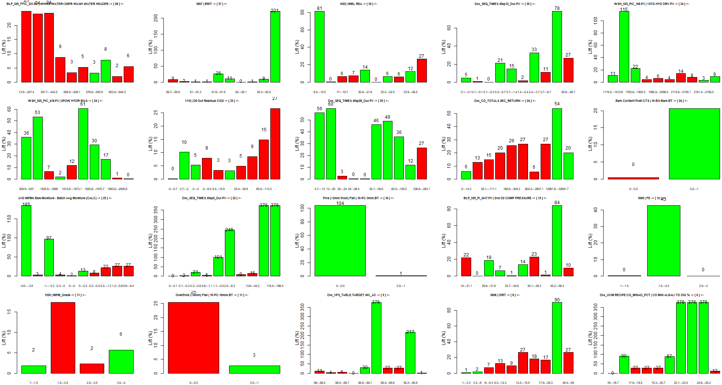
Lifts (BOTTOM 20)

Slide 18
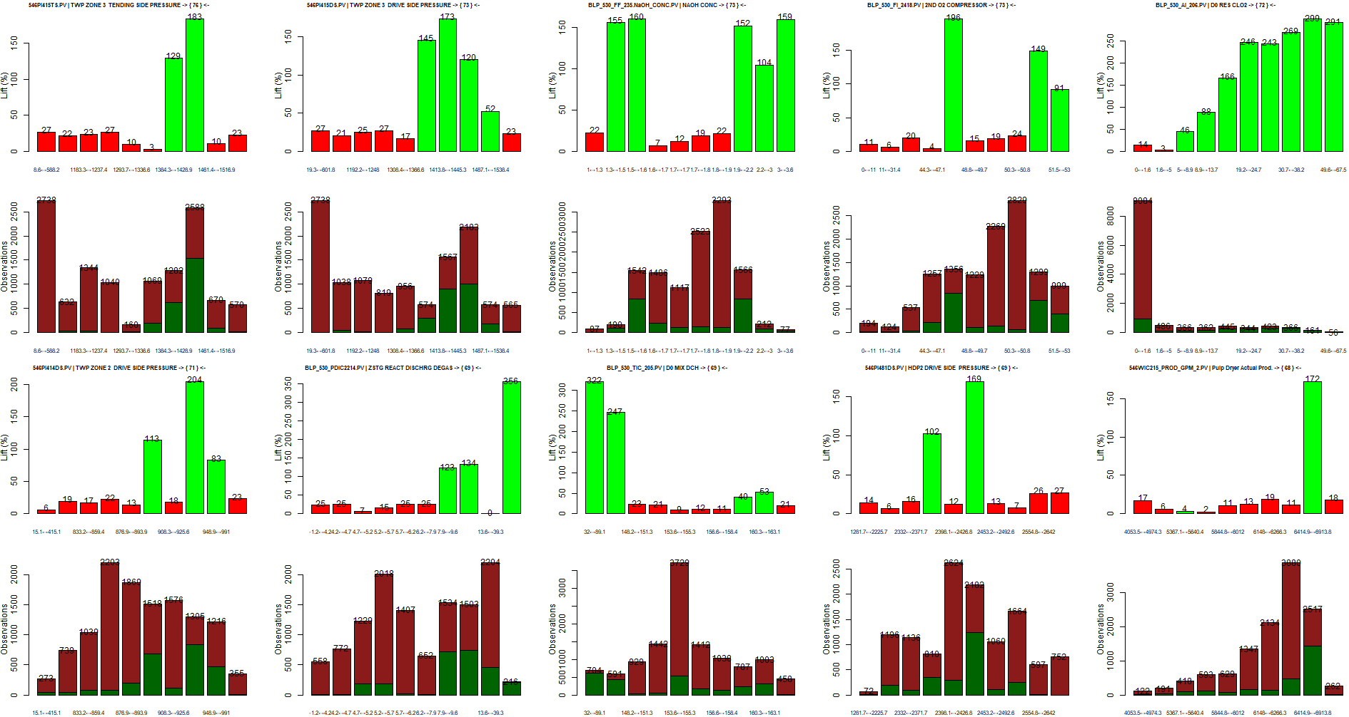
Lifts + Frequencies (TOP 10)

Slide 19
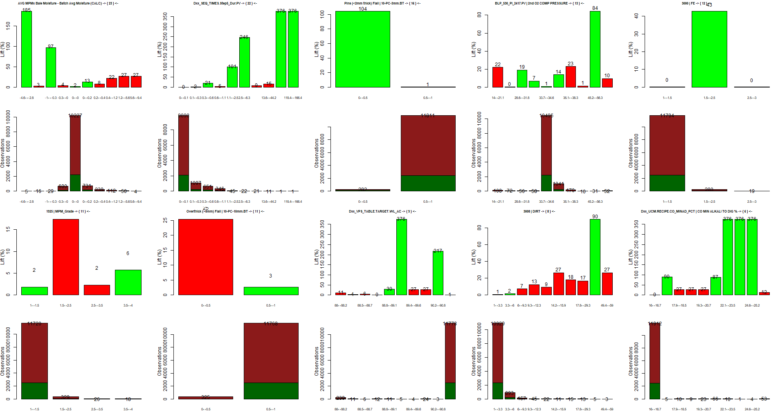
Lifts + Frequencies (BOTTOM 10)

Slide 20
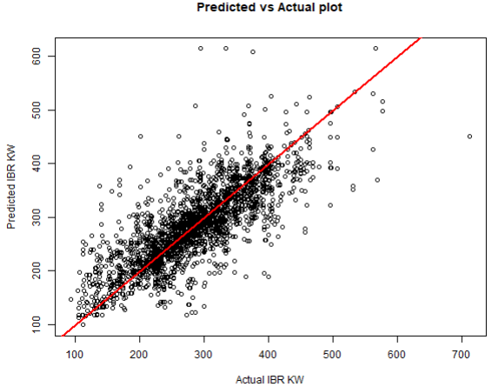
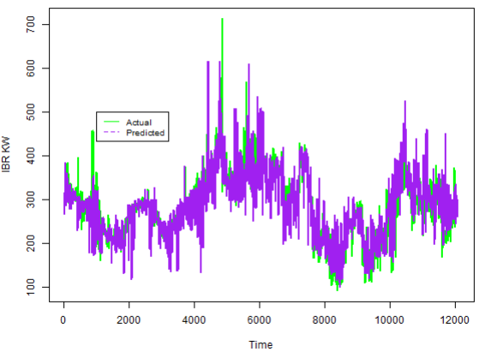
Predicted vs. Actual
Root Mean Square Error: 49.4 Standard Deviation: 77.7 Mean: 285.2 Coefficient of Variation = Standard Deviation / Mean = 27.2%
RMSE
Mean = 17.4%
RMSE
Standard Deviation = 63.6% Accuracy = 100 – AVERAGE(100 * (ABS(Prediction – Actual) / Actual)) = 86.79 %

Slide 21
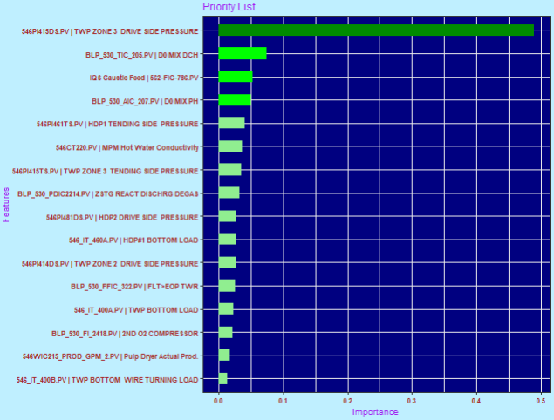
Variable Importance (XGBoost)

Slide 22
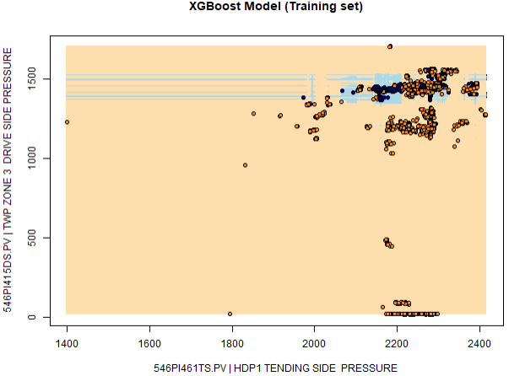
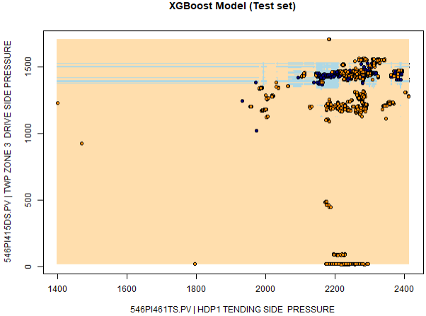
Mind of the Model (2-parameter)
Occam’s razor: Entia non sunt multiplicanda praeter necessitatem, ["Entities must not be multiplied beyond necessity“]
The problem-solving principle that recommends searching for explanations constructed with the smallest possible set of elements.

Slide 23
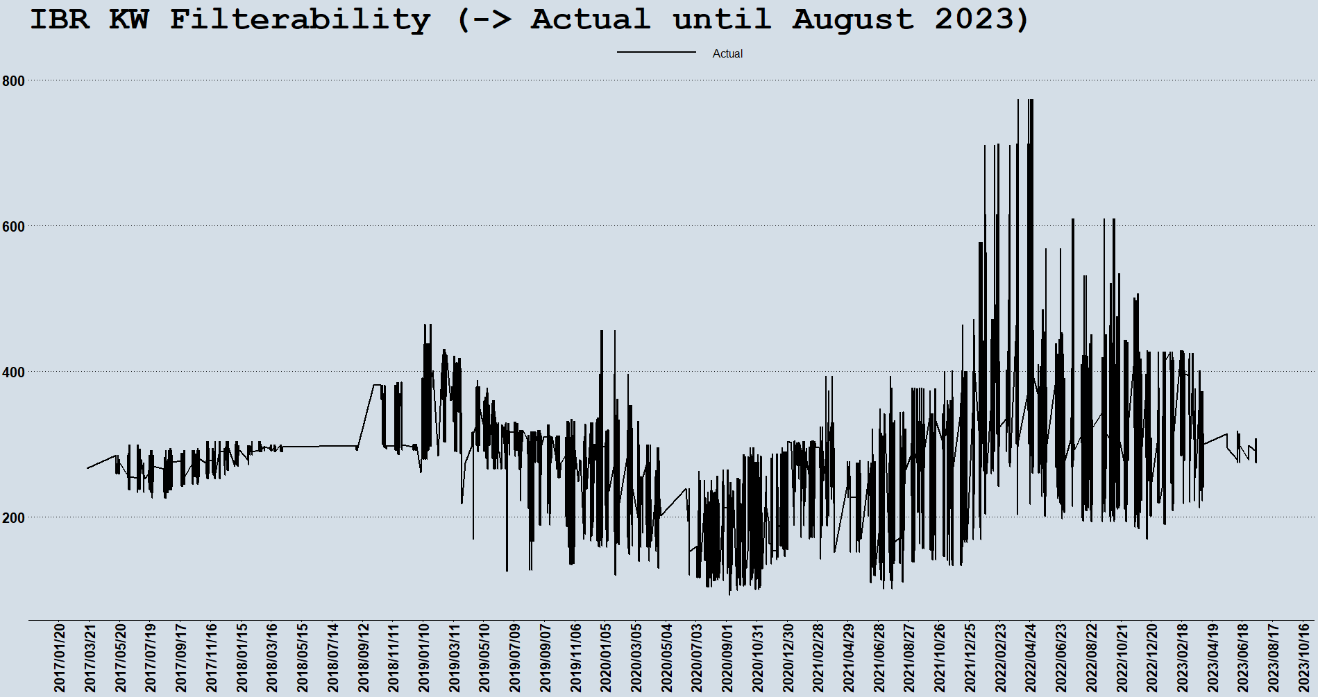
Actual

Slide 24
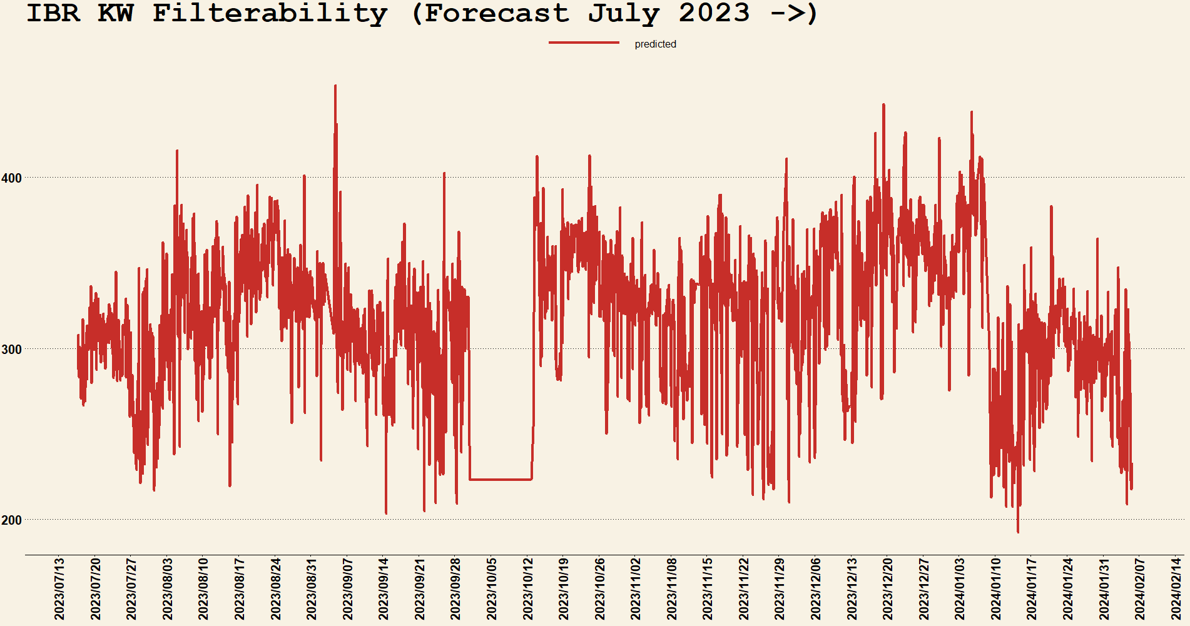
Forecast

Slide 25
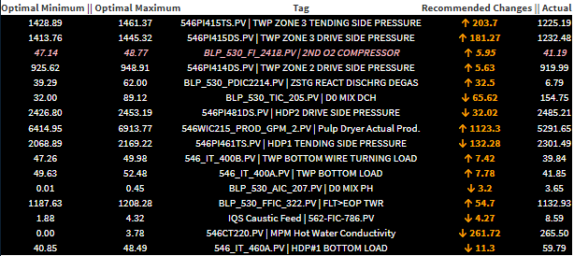
Recommended Settings

Slide 26
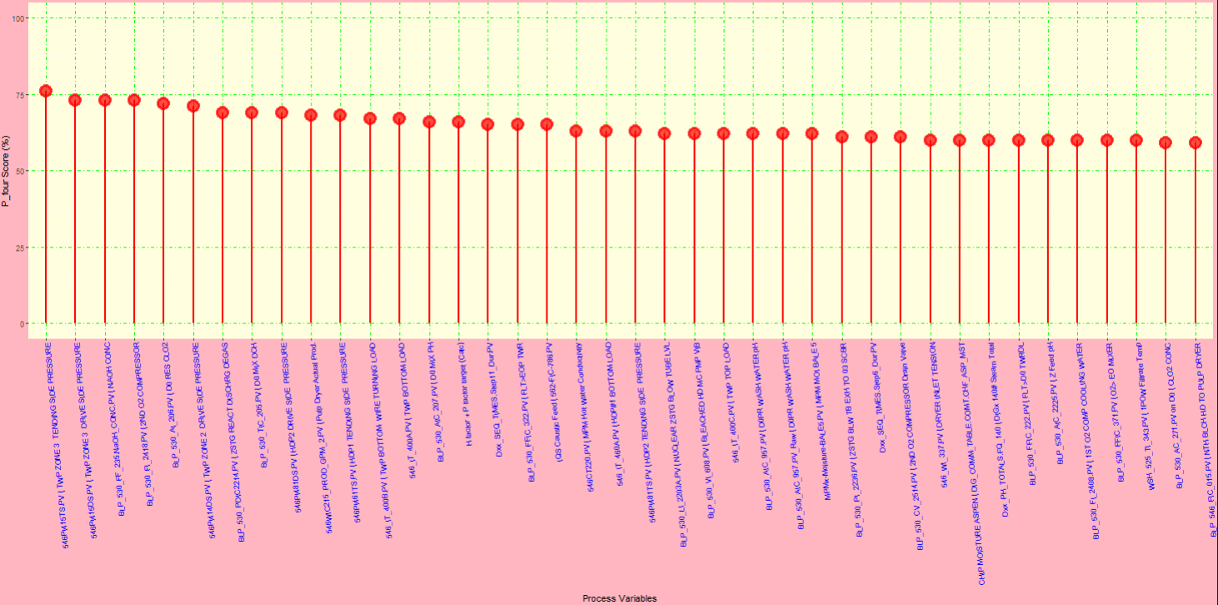
Important Variables

Slide 27
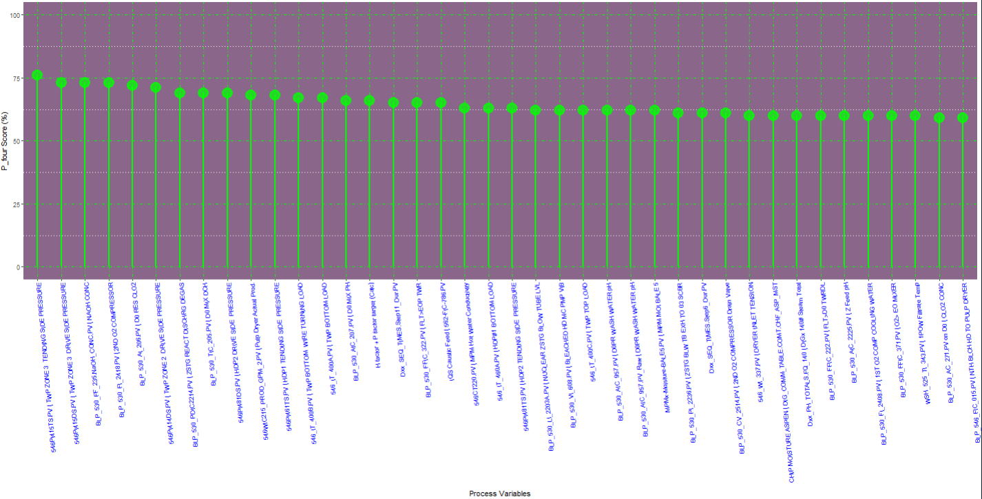
Important Variables

Slide 28
Key Takeaways
The desired levels of IBR KW Filterability values in this study are Loop 1: < 262.2 KW & Loop 2: < 160.1 KW
`TWP Zone 3 Drive Side Pressure` and `TWP Zone 3 Tending Side Pressure` show the highest correlation with IBR KW.
The continuous variables were discretized using the `cluster` method.
The Predicted vs. Actual plot show that the model has a high predictive accuracy (86.79 %).
The IBR KW values are forecasted to be mostly below 320 KW and generally above 200 KW so far in 2024.
A table of Recommended Settings for the most influential variables (not having a lot of missing data) is provided.

